Slide 1
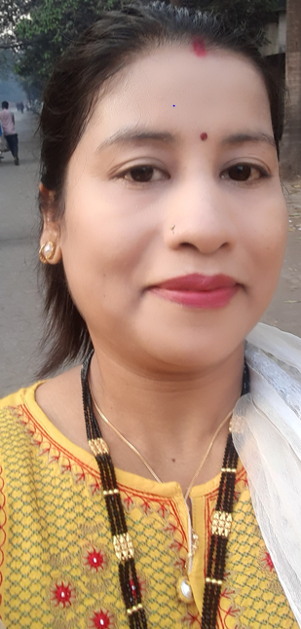
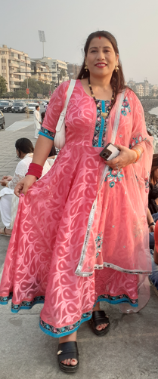
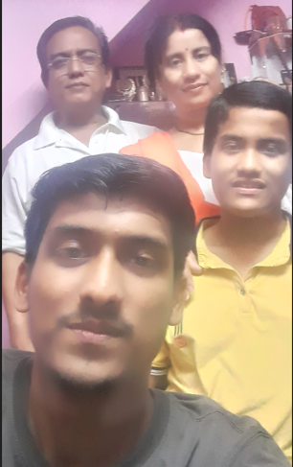
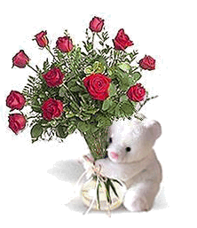

Dear, Sangeeta
19.01.2025
Happy Birthday. My Beautiful Wife. Your life is such a precious gift to me. I’m so happy to celebrate another year with you. May your day be filled with all the happiness, joy, and love your heart can possibly hold! You are an incredible woman. I am one lucky man.
Wishing for you a very special birthday. We Love you.
from: Suraj

